Slide 1
Package Recommendation Using Dependency Graphs
CS5284 – Team 19

Slide 2
Project Focus
The goal of this project is to build a model that analyzes metadata about a project, such as its existing dependencies, the topic it is based on, and other contextual information, to recommend new dependencies it could use.
During our research, we did not find any other projects trying to solve this problem or solve it using Graph ML techniques.

Slide 3
Project Steps
Data modelling
Data Pipeline creation for projects and packages
Sample dataset creation for model training
Implement the following models :
Memory-Based Collaborative Filtering (Items-based)
Low-Rank Matrix Collaborative Filtering
PageRank
Graph-Based Content Filtering
Result Analysis

Slide 4
Data Model Assumptions
To reduce our project scope we only consider -
The package names when linking dependencies not versions
JavaScript based projects using NPM for package management

Slide 5
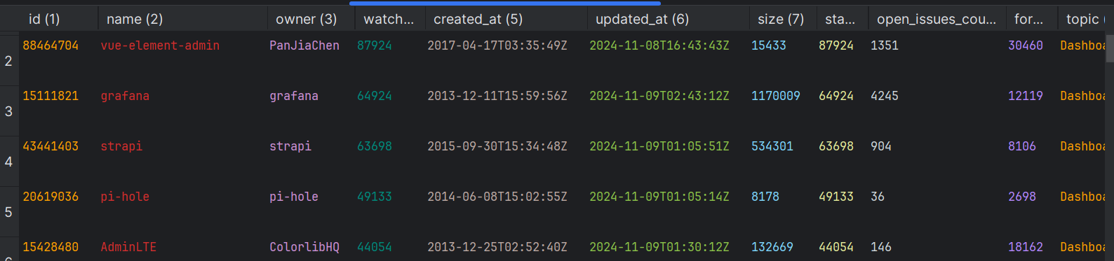
Dataset Creation
Projects (Content)
Used Githubs REST API to get data on user projects
In particular used the Github Search API with the following parameters
Primary language : JS
Topic/Tag: CMS, Payroll, etc.
Sort by star count and defined minimum star count threshold

Slide 6
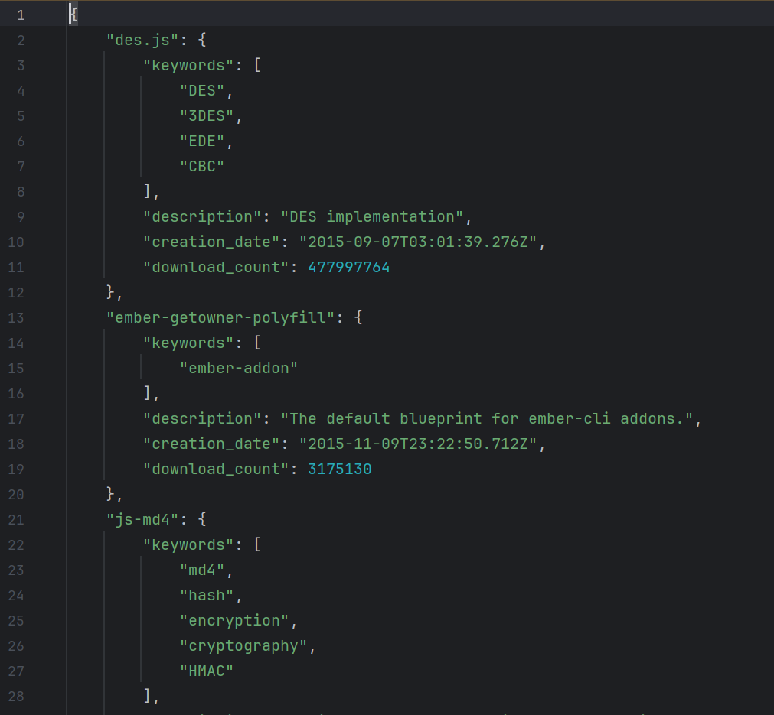
Dataset Creation
Packages
Use the NPM Registry API to fetch package details
Create a package space using top GitHub projects
Features Considered
Keywords
Description
Number of downloads
Figure 1: Preview of package features

Slide 7
Memory-Based Collaborative Filtering (Items-based)
Model

Slide 8
Memory Based CF
Memory based CF models are simple recommendation systems which predict a user’s preference based on the similarities between users or items.
In our case the users are the Github Projects and the content to be recommended are the NPM packages.
We perform simple items-based memory CF using cosine similarity as our similarity metric.

Slide 9
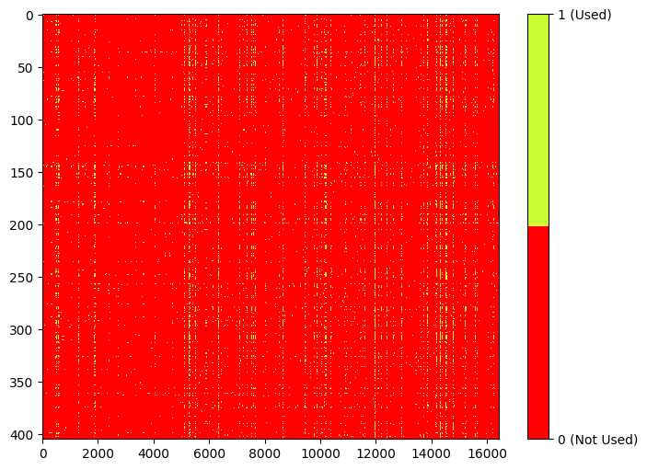
GrounD Truth
Before we can build our model, we need to define a ground truth matrix. This is defined by keeping the projects as the rows and all the package dependencies as columns. We give a value of 1 if the package is used by a project and 0 if not.
As we can see, our data is sparse with most packages being used in only a handful of projects.

Slide 10
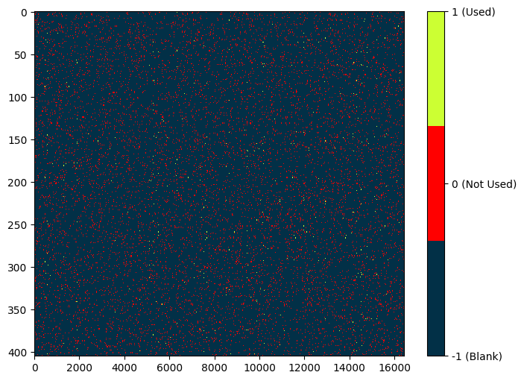
Training Matrix
For our training matrix, we apply a mask over the ground truth matrix. We mask 95% of known values, replacing them with a value of -1. These are the packages we want our model to predict.

Slide 11
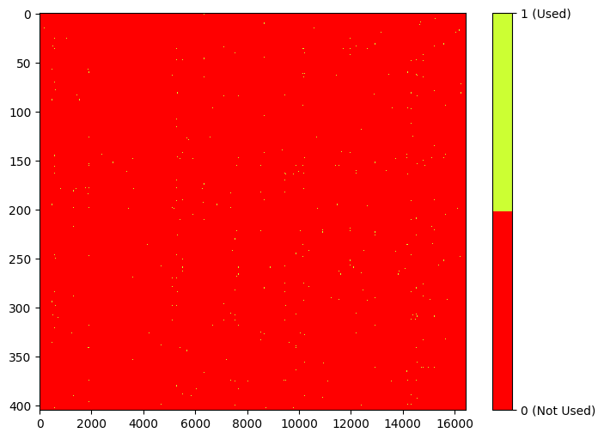
Model Result
Ground truth (For comparison)
RSME = 0.18985931087867747

Slide 12
Low-Rank Matrix Collaborative Filtering
Model

Slide 13
Low-Rank Matrix CF
Low-Rank Matrix Collaborative Filtering works by decomposing ground truth matrix into lower dimensional latent factors. These factors capture hidden patterns, such as similarities between projects and shared usage trends among packages.
This helps the model to predict the likelihood of a package being relevant to a project, even if the project has no prior interaction with that package, making it highly effective for a sparse datasets like ours.

Slide 14
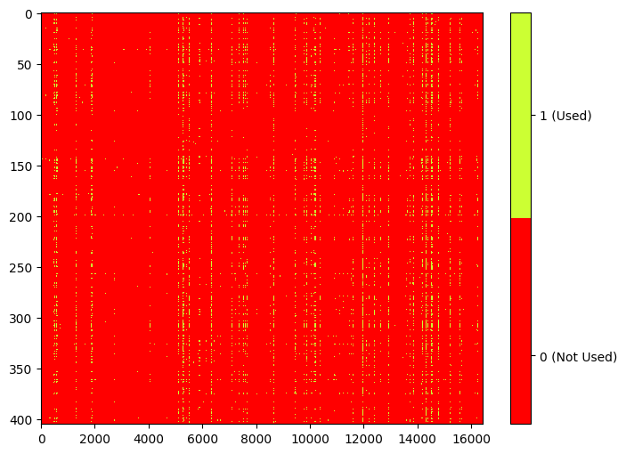
Result
Ground truth (For comparison)
RSME = 0.08638970308679021

Slide 15
Page Rank
Model

Slide 16
PageRank
Construct a co-dependency graph from project data
Nodes represent packages
Edge between nodes indicates they appear together as dependencies in a project
Use PageRank algorithm to rank packages for recommendation
Improve PageRank recommendation by implementing topic-specific PageRank

Slide 17
Pagerank CO-Dependency Graph
Limitation
Package Space consists of ~16000 nodes
Computation of full graph is too expensive
Workaround
Sort packages by popularity within each project (download count)
Select top k packages and create an edge between every pair of packages
We considered 3 values of k
100
300
500

Slide 18
Topic-Specific PageRank
Consider an input set of keywords (for testing we use project topics)
Compute how closely each package fits those keywords and assign a score
Higher similarity packages should get more importance
Run PageRank with these importance scores

Slide 19
PageRank Results
V – Vanilla PageRank
E – PageRank with edge-weights
P – PageRank with personalization
TS – Topic-specific PageRank
PageRank Model | RMSE(Limit=100) | RMSE(Limit=300) | RMSE(Limit=500)
V | 0.18946835228967515 | 0.18716205274311482 | 0.1865130635372371
V(E) | 0.18840229196293373 | 0.18621596371394109 | 0.18573929194740293
V(P) | 0.18840229196293373 | 0.18621717403631108 | 0.1862615470922385
V(E+P) | 0.18625993371178068 | 0.18616149106301383 | 0.18617077271513052
TS | 0.1646278993694155 | 0.150243359227015 | 0.1443565967370671
TS(E) | 0.16557937029977407 | 0.15009627611749693 | 0.1420376751504513

Slide 20
Graph-Based COntent Filtering
Model

Slide 21
Graph Construction
Construct KNN graphs for packages and projects
Consider text features and numerical features separately

Slide 22
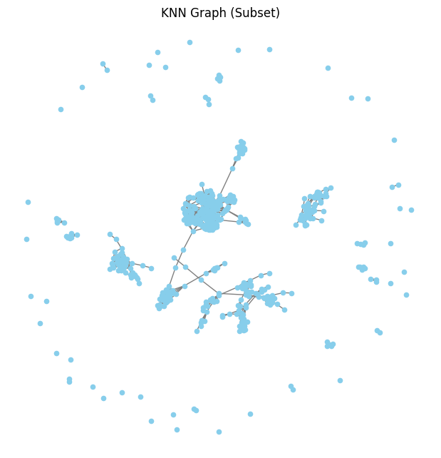
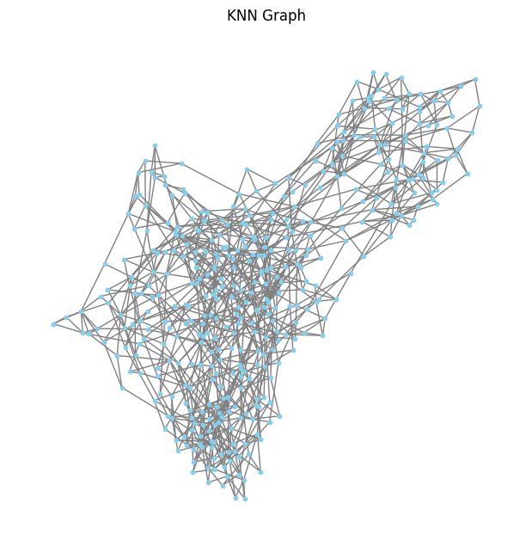
Graph ConsTruction (contd.)
Figure 1: Package KNN Graph (Subset)
Figure 2: Project KNN Graph

Slide 23

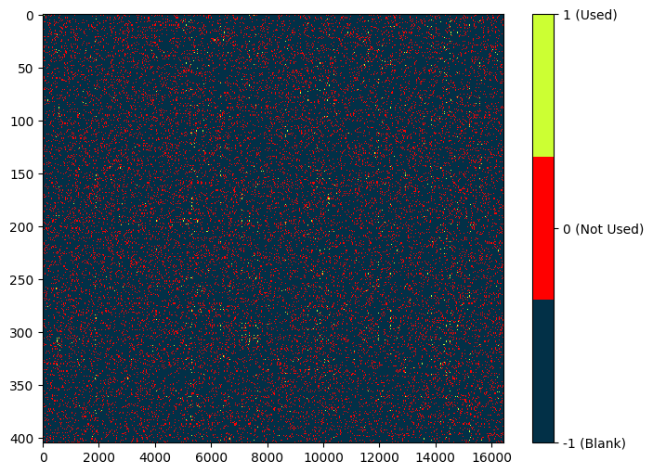
Model Training
Ground Truth
Training Matrix

Slide 24

Result
Ground Truth
Training Matrix

Slide 25
Analysis
Model | RMSE | Runtime
Memory based Collaborative Filtering (Item based) | 0.18985931087867747 | 8.699s
Low-Rank Matrix Collaborative Filtering | 0.08638970308679021 | 21.549s
PageRank (Topic Specific + Weighted) | 0.1443565967370671 | 29min 31s
Graph based Content Filtering | 0.1661170458956928 | 16.360s

Slide 26
ImproveMents and Future Scope
Model can be extended for other languages and ecosystems
Conflict Resolution
Automated Dependency Management

